Slide 1

Let’s find a Data Scientist
Or: Salary offerings to build a team dedicated to understanding the analytical needs for developing & promoting our products
Common Ground Homes
For: CEO Jane Doe
CFO Team
HR Team
DSE5002 Faculty
Presented By: Martin Omasta
Notes:
Title slide template

Slide 2
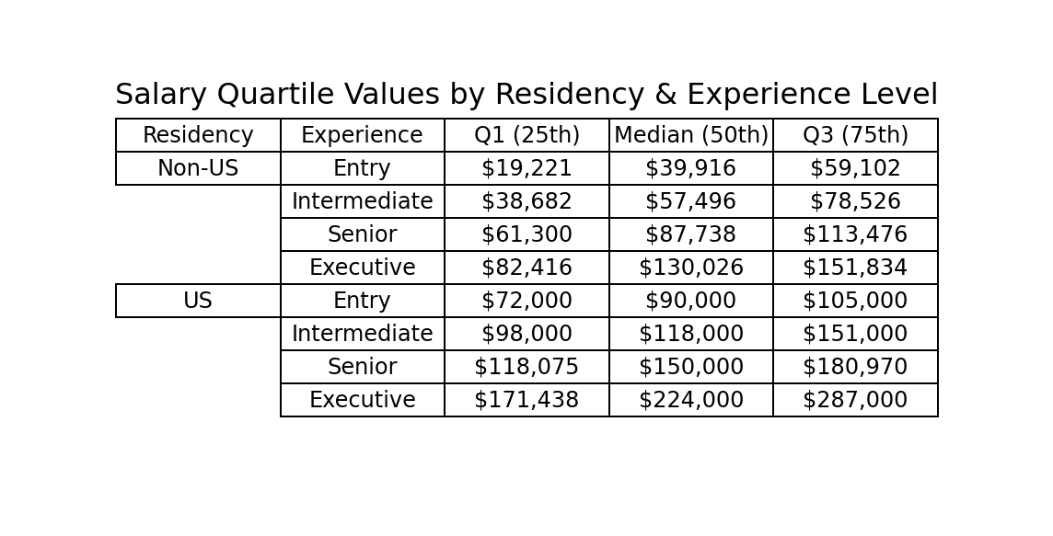
BLUF: Place a job offer for a Senior level Data Scientist (DS) based in the United States with a salary range $140,000 to $180,000 ($80k-$120k Non-US)
WHY?
92% of Data Scientists work within the County they reside; ~80% remotely
Competitive ranges to attract Intermediate DS who are ready to step up, or Senior DS who would be enticed to change jobs:

Slide 3
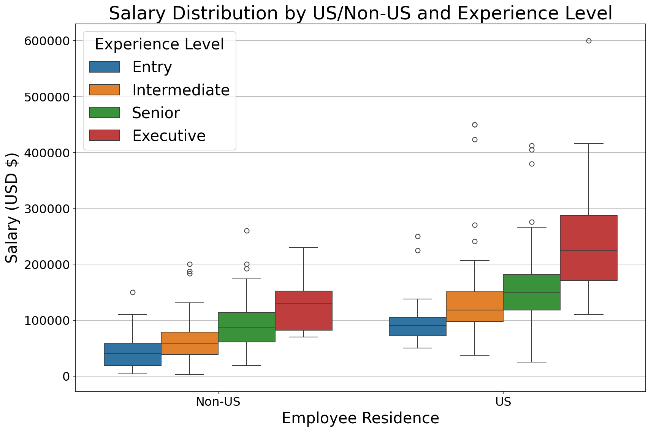
Amplify: There can be significant financial savings (upwards of 60%) by hiring outside the US
Given we are US based & want to build an interactive team for our growing company, be prepared to offer up to two additional Intermediate level DS United States based positions with a salary range $105,000 to $140,000 ($45k-$80k Non-US)

Slide 4
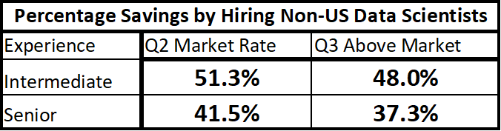
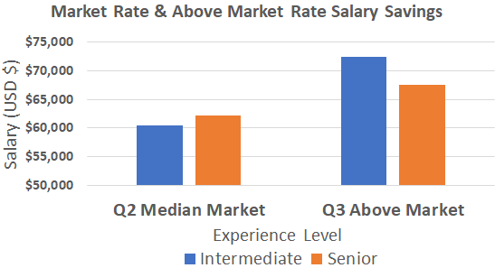
Team, the decision is up to you. Here are some Courses of Action (COA):
COA 1:
US salaries: Team of 3/annually: $460,000
(1 Senior + 2 Intermediate)
Advantages: Cohesion, Lower Operational Friction, US Based Clients, Payroll Compliance, COA 3 – Mix w/Non-US for global balance
Disadvantages: Talent Scarcity, Wage Inflation
Non-US Data Scientists
Save ~$70k
COA 2:
Save ~$60k
Non-US salaries: Team of 3/annually: $269,000
(1 Senior + 2 Intermediate)
Advantages: Larger Talent Pool, Salary Savings, Outside Perspectives, C-Suite C(I/T)O cost about the same as US Senior Level DS
Disadvantages: Time Zones, Synchronous Collaboration, Decision Making Flow

Slide 5
EXTRA WORK SLIDES

Slide 6
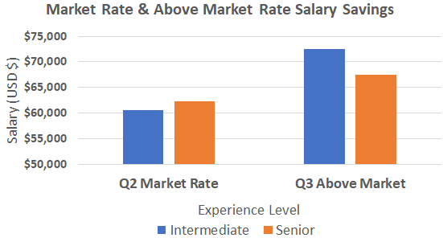
Team, the decision is up to you. Here are some Courses of Action (COA):
COA 1:
US salaries: Team of 3/annually: $460,000
(1 Senior + 2 Intermediate)
Advantages: Cohesion, Lower Operational Friction, US Based Clients, Payroll Compliance, COA 3 – Mix w/Non-US for global balance
Disadvantages: Talent Scarcity, Wage Inflation
Non-US Data Scientists
Save ~$70k
COA 2:
Save ~$60k
Non-US salaries: Team of 3/annually: $269,000
(1 Senior + 2 Intermediate)
Advantages: Larger Talent Pool, Salary Savings, Outside Perspectives, C-Suite C(I/T)O cost about the same as US Senior Level DS
Disadvantages: Time Zones, Synchronous Collaboration, Decision Making Flow

Slide 7
Team, the decision is up to you. Here are some Courses of Action (COA):
COA 1:
US salaries: Team of 3/annually: $460,000
(1 Senior + 2 Intermediate)
Advantages: Cohesion, Lower Operational Friction, US Based Clients, Payroll Compliance
Disadvantages: Talent Scarcity, Wage Inflation
Non-US Data Scientists
Save ~$70k
COA 2:
Save ~$60k
Non-US salaries: Team of 3/annually: $269,000
(1 Senior + 2 Intermediate)
Advantages: Larger Talent Pool, Salary Savings, Outside Perspectives, Could Mix with US Based -> for “follow the Sun” global presence COA 3
Disadvantages: Time Zones, Synchronous Collaboration, Decision Making Flow

Slide 8
Team, the decision is up to you. Here are some Courses of Action (COA):
COA 1:
US salaries: Team of 3/annually: $460,000
(1 Senior + 2 Intermediate)
Advantages: Cohesion, Lower Operational Friction, US Based Clients, Payroll Compliance
Disadvantages: Talent Scarcity, Wage Inflation
Non-US Data Scientists
Save ~$70k
COA 2:
Save ~$60k
Non-US salaries: Team of 3/annually: $269,000
(1 Senior + 2 Intermediate)
Advantages: Larger Talent Pool, Salary Savings, Outside Perspectives, Could Mix with US Based -> for “follow the Sun” global presence COA 3
Disadvantages: Time Zones, Synchronous Collaboration, Decision Making Flow

Slide 9
Team, the decision is up to you. Here are some Courses of Action (COA):
COA 1:
US salaries: Team of 3/annually: $460,000
(1 Senior + 2 Intermediate)
Advantages: Cohesion, Lower Operational Friction, US Based Clients, Payroll Compliance
Disadvantages: Talent Scarcity, Wage Inflation
Non-US Data Scientists
~$70k
Less
COA 2:
~$60k
Less
Non-US salaries: Team of 3/annually: $269,000
(1 Senior + 2 Intermediate)
Advantages: Larger Talent Pool, Salary Savings, Outside Perspectives, Could Mix with US Based -> for “follow the Sun” global presence COA 3
Disadvantages: Time Zones, Synchronous Collaboration, Decision Making Flow

Slide 10
Team, the decision is up to you. Here are some Courses of Action (COA):
COA 1:
US salaries: Team of 3/annually: $460,000
(1 Senior + 2 Intermediate)
Advantages: Cohesion, Lower Operational Friction, US Based Clients, Payroll Compliance
Disadvantages: Talent Scarcity, Wage Inflation
Non-US Data Scientists
~$70k
COA 2:
~$60k
Non-US salaries: Team of 3/annually: $269,000
(1 Senior + 2 Intermediate)
Advantages: Larger Talent Pool, Salary Savings, Outside Perspectives, Could Mix with US Based -> for “follow the Sun” global presence COA 3
Disadvantages: Time Zones, Synchronous Collaboration, Decision Making Flow

Slide 11
Team, the decision is up to you. Here are some Courses of Action:
COA 2:
US salaries:
Advantages:
Disadvantages:
Non-US salaries:
Advantages:
Disadvantages:
COA 1:

Slide 12
Team, the decision is up to you. Here are some Courses of Action:
COA 1:
COA 2:
Non-US salaries:
Advantages:
Disadvantages:
US salaries:
Advantages:
Disadvantages:

Slide 13
Team, the decision is up to you. Here are some Courses of Action:
COA 1:
COA 2:
Non-US salaries:
Advantages:
Disadvantages:
US salaries:
Advantages:
Disadvantages:

Slide 14
Team, the decision is up to you. Here are some Courses of Action:
COA 2:
US salaries:
Advantages:
Disadvantages:
COA 1:
Non-US salaries:
Advantages:
Disadvantages:

Slide 15
Team, the decision is up to you. Here are some Courses of Action:

Slide 16
What are the ranges of salaries for the 4 categories of experience? Interquartile Range 25%-75% salary range/band
Also determine what mix of experience types we should consider
Do we pay a premium for an employee who lives in the U.S.?
Could do a regression and give a confidence interval

